Slide 1
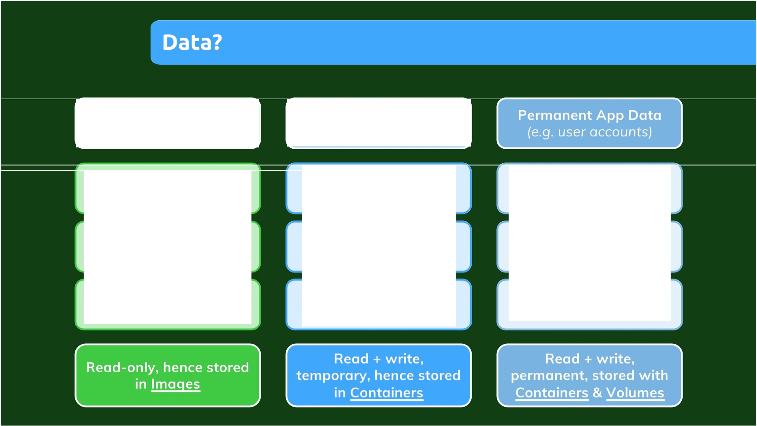
Application
Temporary App Data
(Code + Environment)
(e.g. entered user input)
Written & provided by you (= the developer)
Fetched I Produced in running container
Fetched I Produced in running container
Added to image and container in build phase
Stored in memory or temporary files
Stored in files or a database
"Fixed": Can't be changed once image is built
Dynamic and changing, but cleared regularly
Must not be lost if container stops I restarts

Slide 2
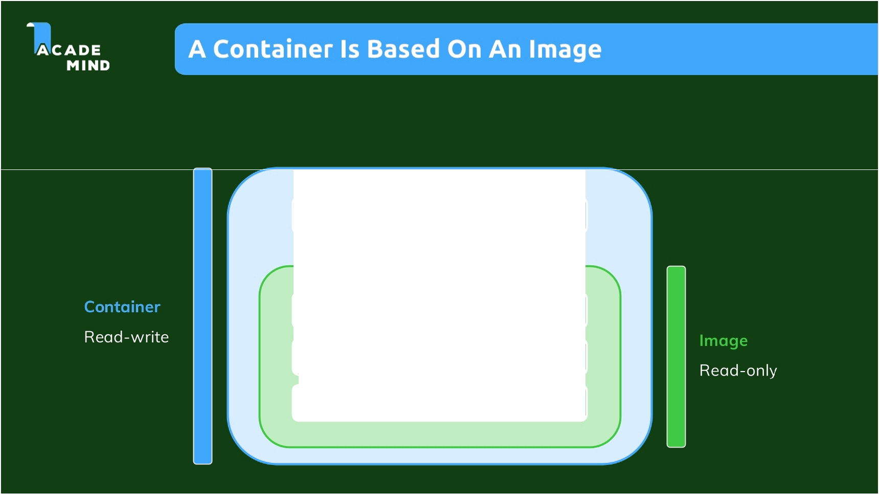
Container Layer (read-write)
Instruction #3: Image Layer 3
Instruction #2: Image Layer 2
Instruction #1: Image Layer 1

Slide 3
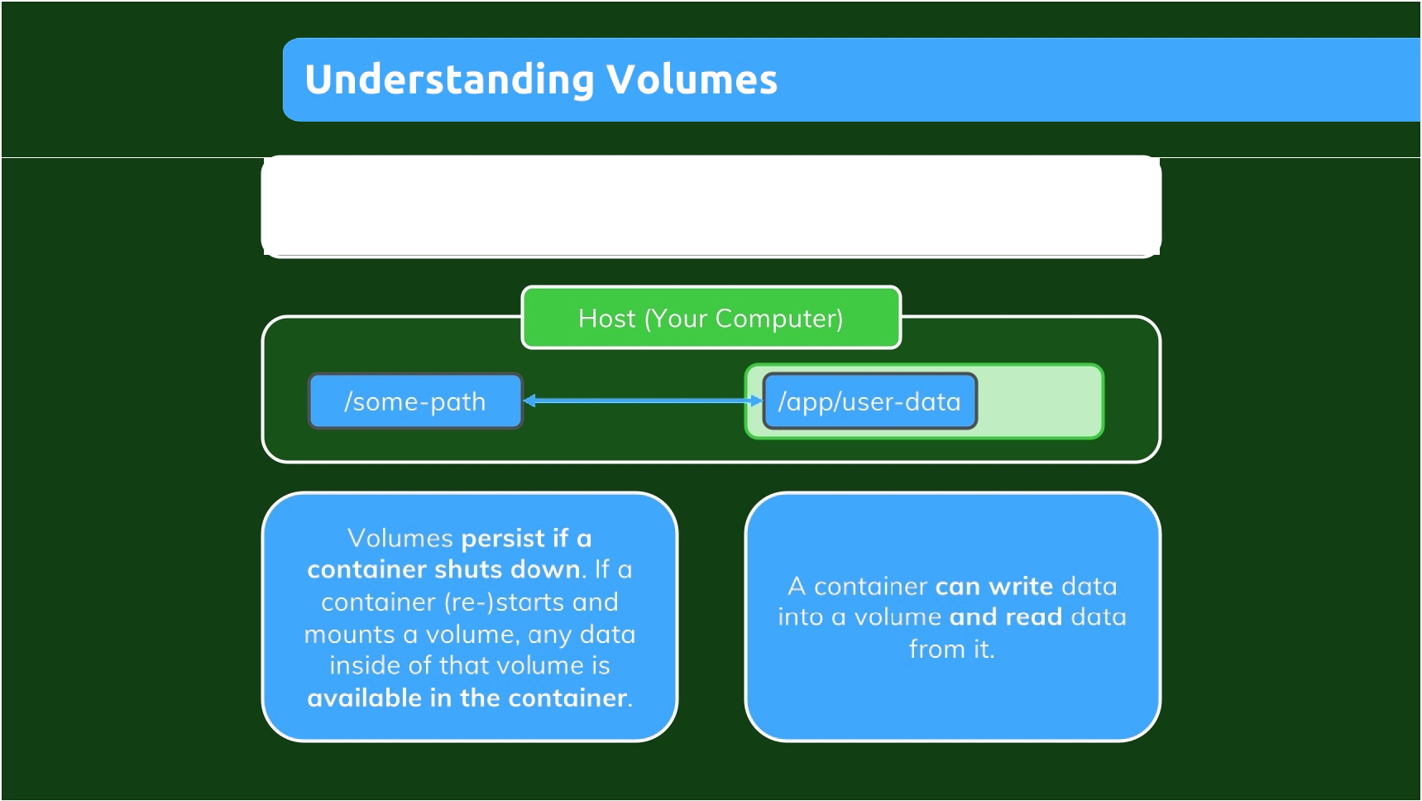
Volumes are -f o dcrs on you r h ost m och ir c hard drive which are
1-ru.:.r u 1ted ("made available", mapped) in to con-cu rt ers

Slide 4
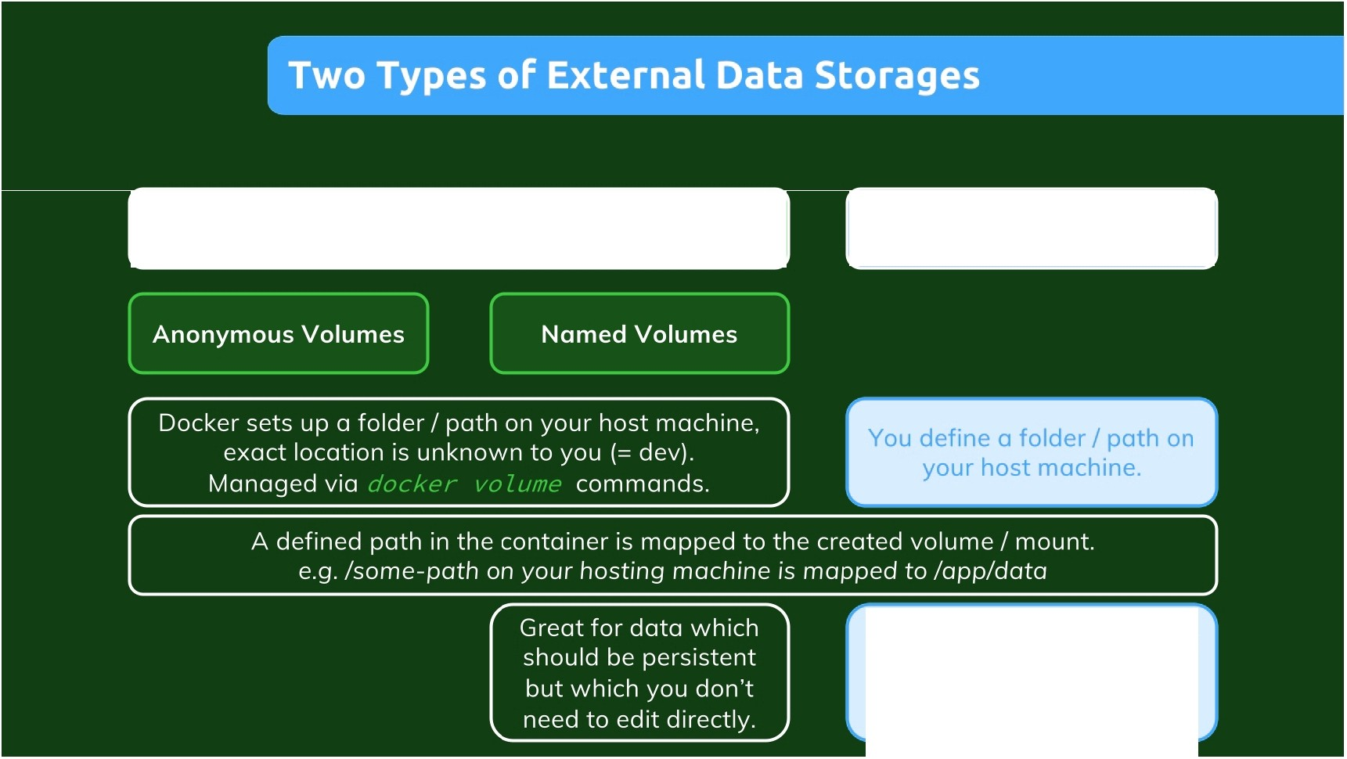
Volumes
Bind Mounts
(Managed by Docker)
(Managed by you)
Great for persistent, editable (by you) data
(e.g. source code).

Slide 5
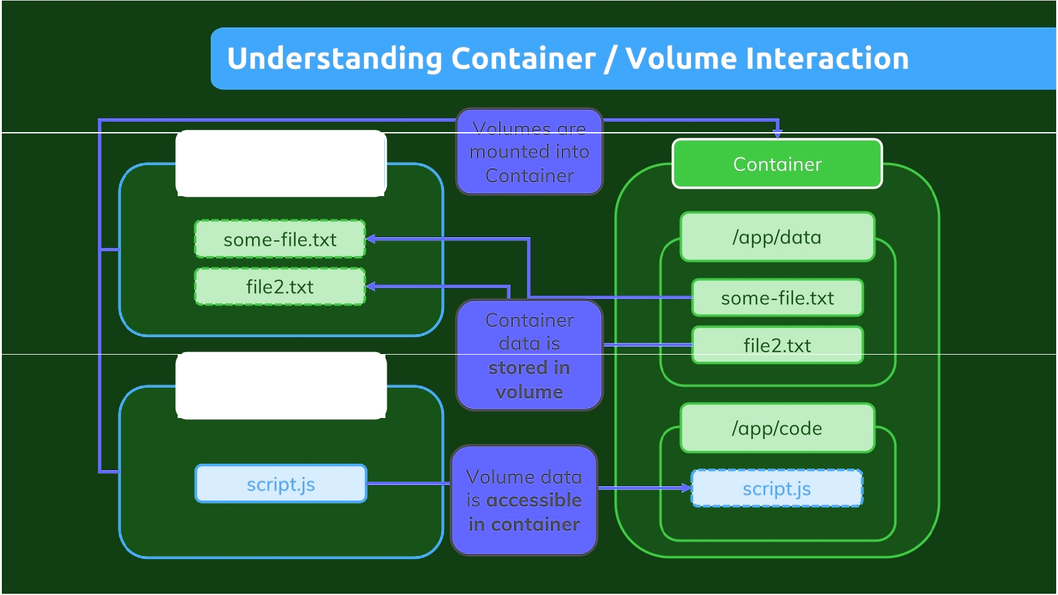
Volume
/some-path
Bind Mount
/some-other-path

Slide 6
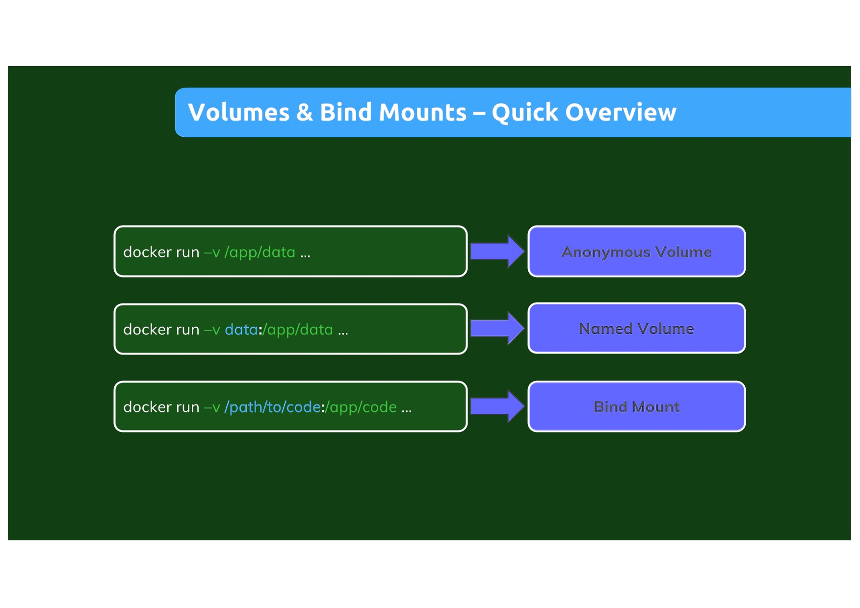

Slide 7
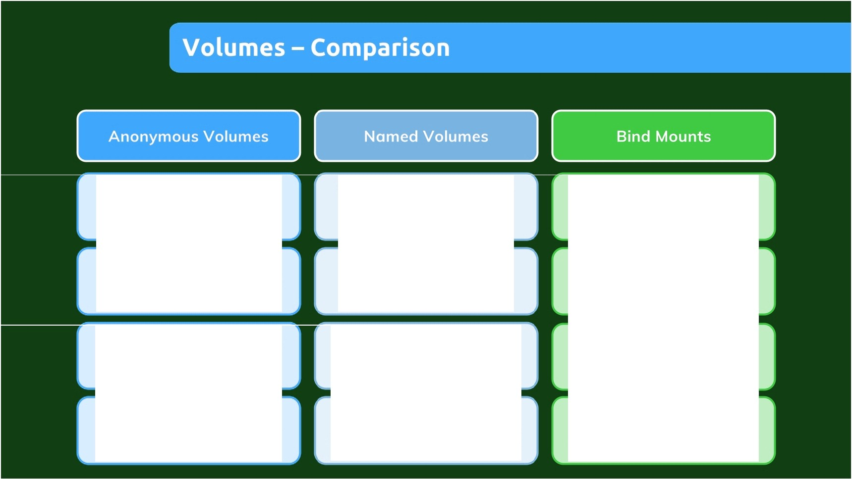
Created specifically for a single container
Created in general - not tied to any specific container
Location on host file system, not tied to any specific container
Survives container shutdown I restart unless
--rm is used
Survives container shutdown I restart - removal via Docker CLI
Survives container shutdown I restart - removal on host fs
Can not be shared across containers
Can be shared across containers
Can be shared across containers
Since it's anonymous, it can't be re-used (even on same image)
Can be re-used for same container (across restarts)
Can be re-used for same container (across restarts)

Slide 8
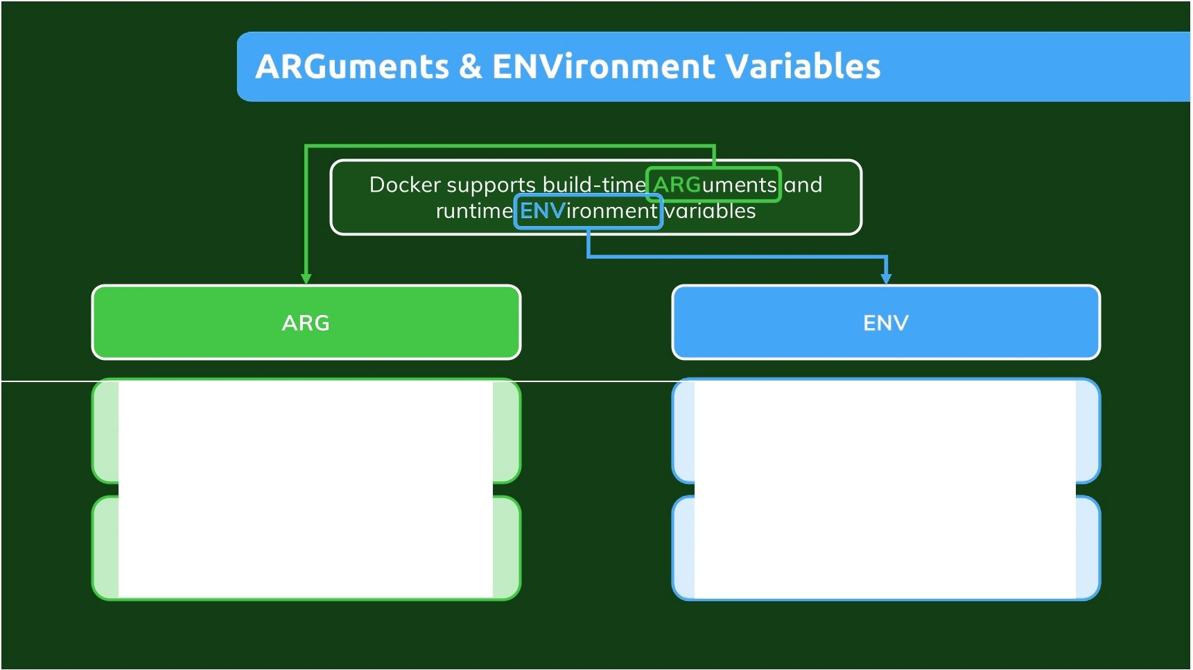
Available inside of Dockerfile, NOT accessible in CMD or any application code
Available inside of Dockerfile & in application code
Set on image build (docker bui ld)
via --bui d-a rg
Set via ENV in Dockerfile or via --env on docke r run

Slide 9
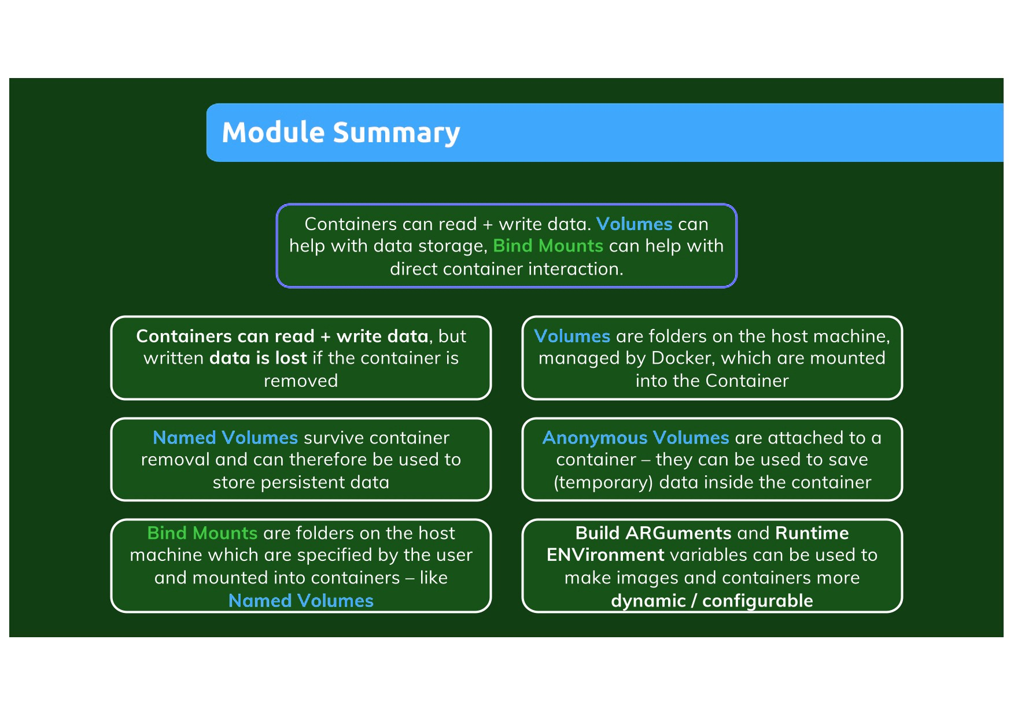

Slide 10
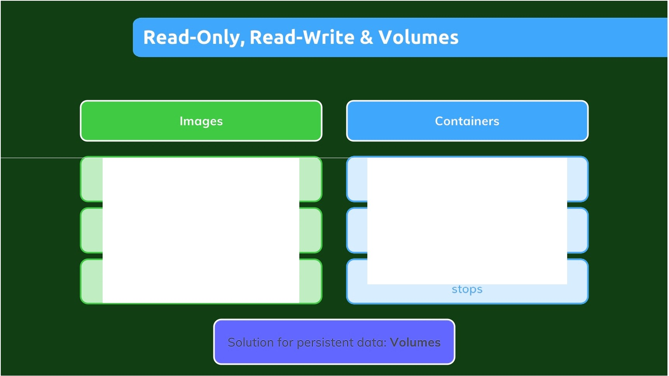
Read-only
Read & Write
Once created, you need to re-build them to change something
A running container can store data (e.g. incoming user data)
Application data (e.g. user data) is
NOT stored in images
But: Data is lost when a container

